Slide 1
Microservices Architecture

Slide 2




Who I Am?
Domain Driven Design (DDD)
Test Driven Development (TDD)
Behavior Driven Development (BDD)
Event-Driven Architecture (EDA)
CQRS, Event Sourcing
Microservices Architecture
@azadmt

Slide 3
What is Software Architecture
Generically, architecture is the description of the set of components and the relationships between them
(Frank J. Armour, Stephen H. Kaisler, and Simon Y. Liu (1999). "A big-picture look at enterprise architectures." IT professional Vol 1 (1). p. 35-42.)
Architecture represents the significant design decisions that shape a system, where significant is measured by cost of change.
(Grady Booch (1991) Object-Oriented Design: with Applications. p. 320)
Notes:
https://en.wikiquote.org/wiki/Software_architecture

Slide 4




Architectural Style
An architectural style is a set of characteristics and features that make a structure notable or historically identifiable.

Slide 5
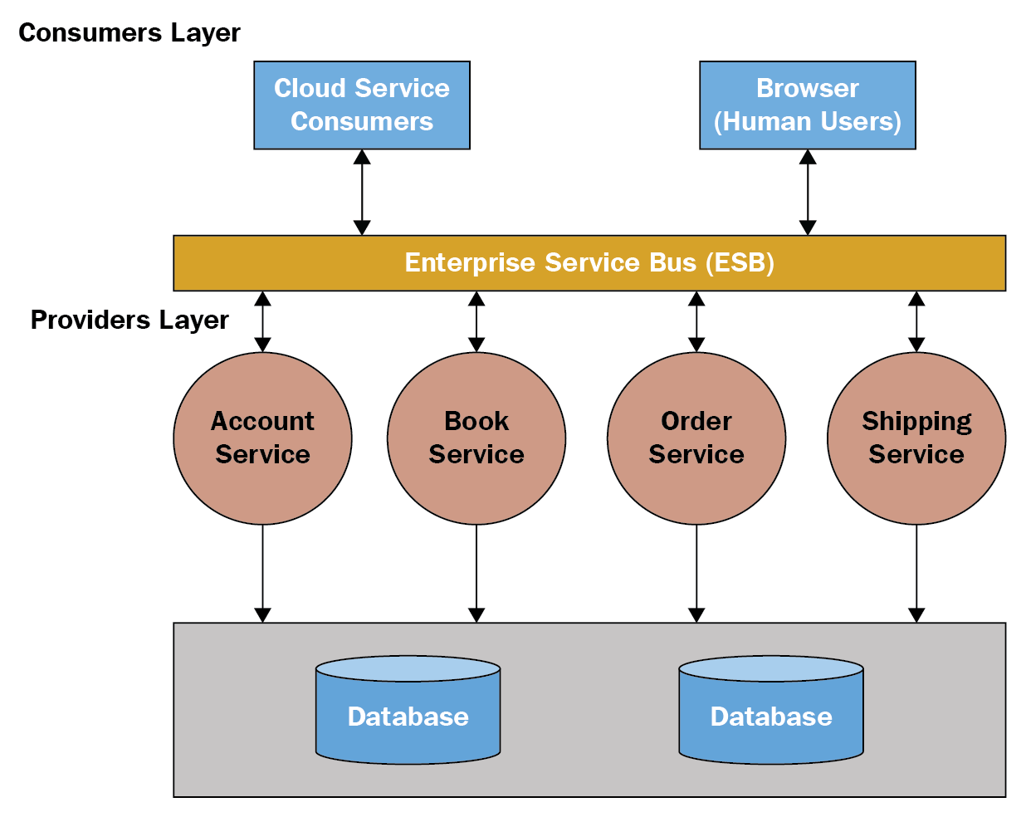
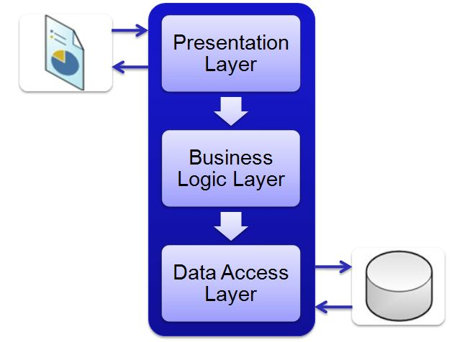
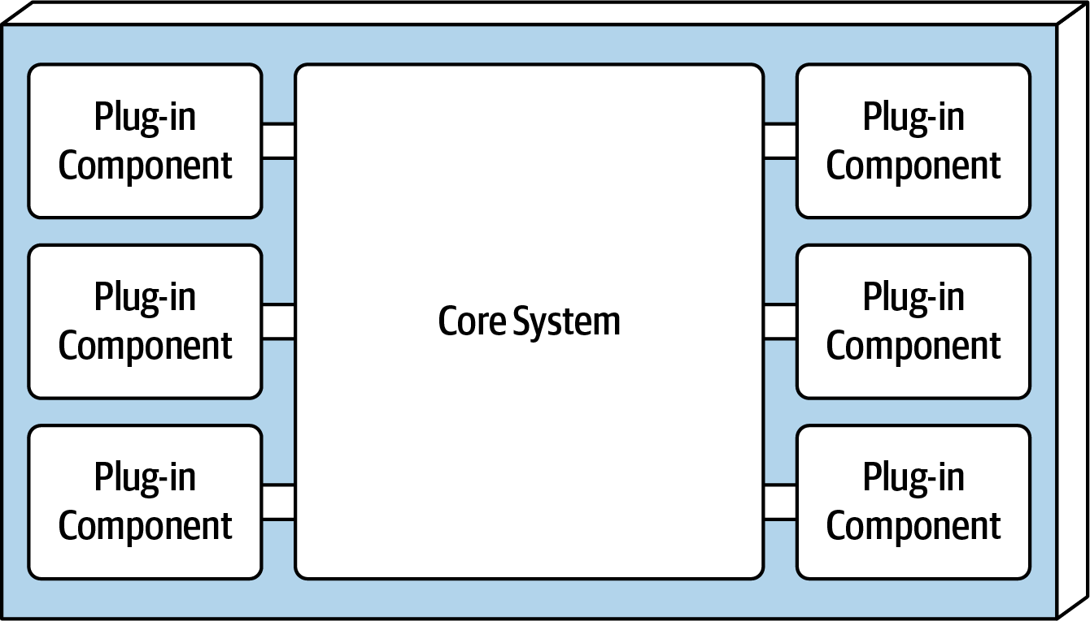
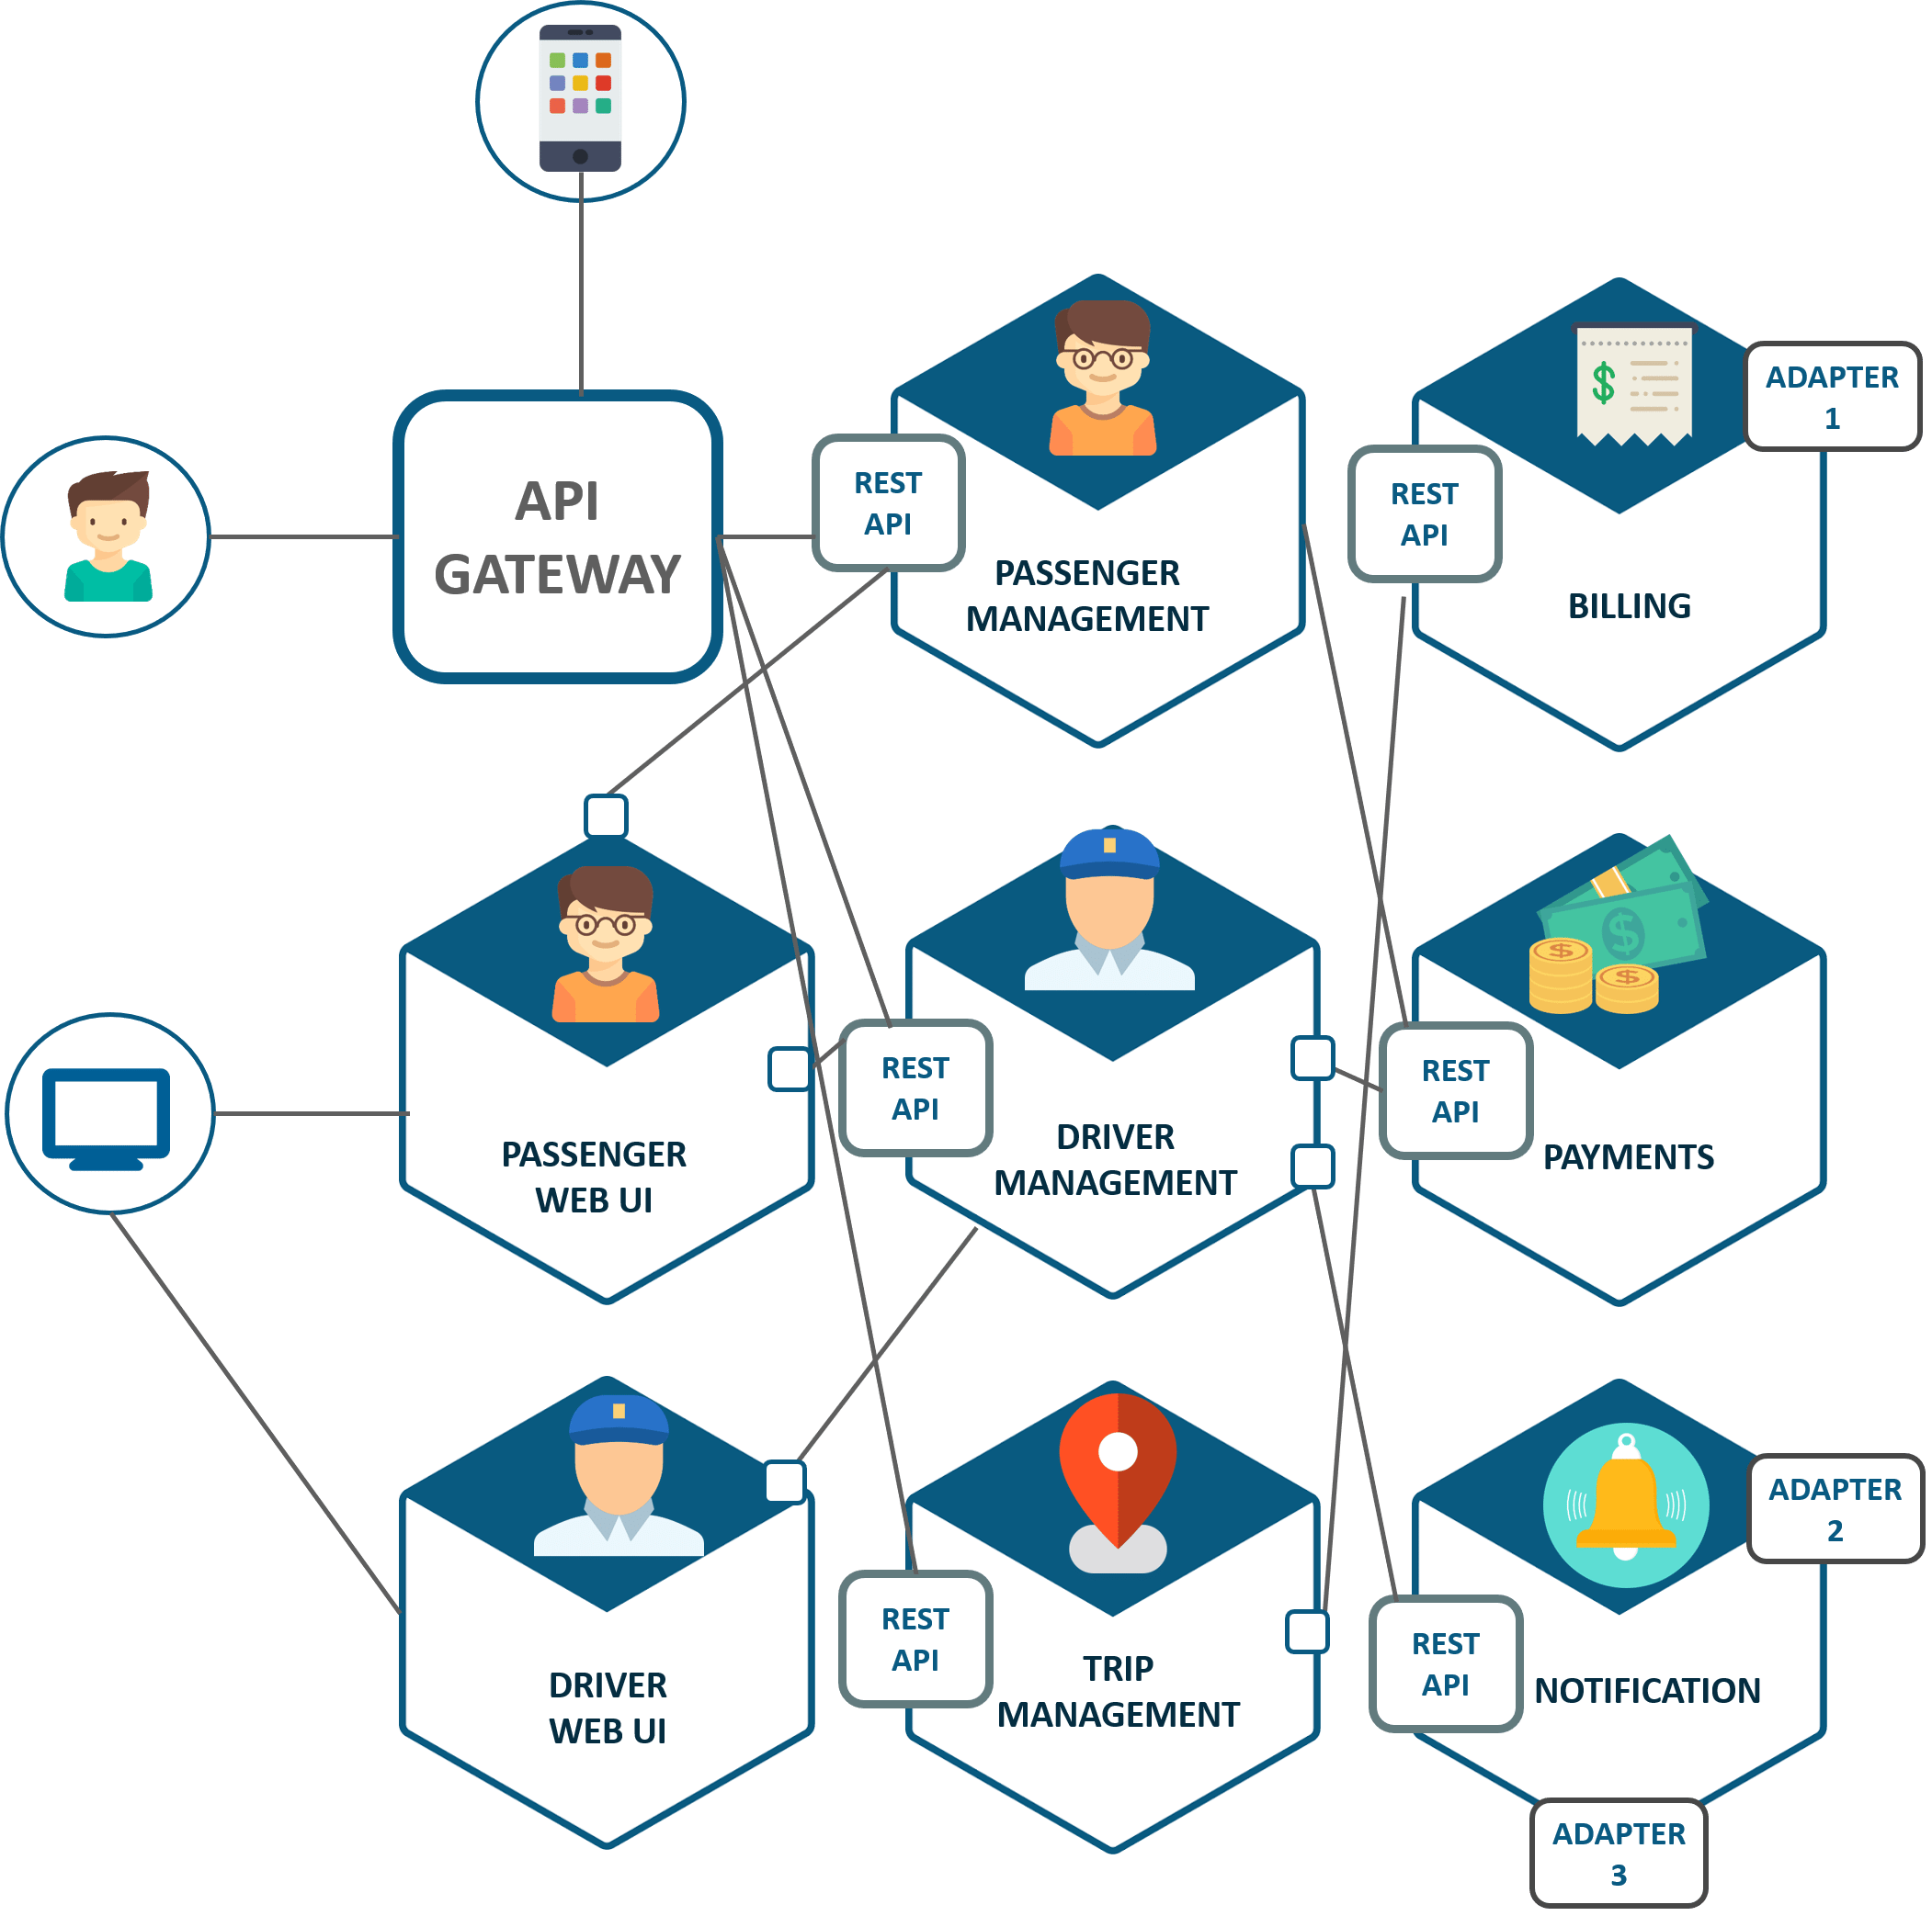
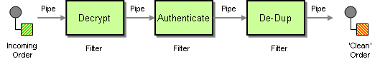
Software Architecture Style

Slide 6
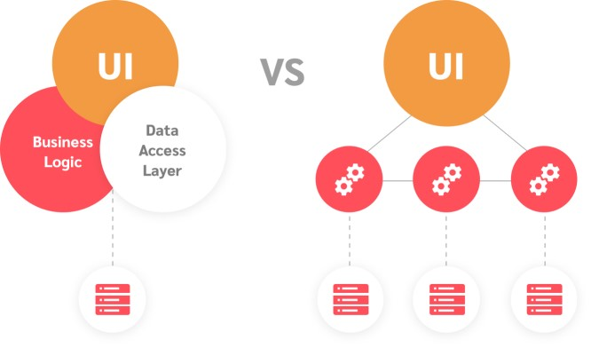
Architectural Style Classification
Monolithic: single deployment unit(Process) of all code
Distributed: multiple deployment units connected through remote access protocols

Slide 7
N-Tier(Layered) Architecture
Components within the layered architecture style are organized into logical horizontal layers, with each layer performing a specific role within the application (such as presentation logic or business logic)
The layered architecture style is a good choice for small, simple applications or websites. It is also a good architecture choice, particularly as a starting point, for situations with very tight budget and time constraints

Slide 8
Microkernel (Plugin) Architecture
The microkernel architecture style (also referred to as the plug-in architecture) was coined several decades ago and is still widely used today. This architecture style is a natural fit for product-based applications (packaged and made available for download and installation as a single,monolithic deployment, typically installed on the customer’s site as a third-party product

Slide 9
Pipe And Filter Architecture
Pipes in this architecture form the communication channel between filters. Each pipe is typically unidirectional and point-to-point (rather than broadcast) for performance reasons, acceptin input from one source and always directing output to another
Filters are self-contained, independent from other filters, and generally stateless. Filters should perform one task only g input from one source and always directing output to another

Slide 10
Service Oriented Architecture
SOA, or service-oriented architecture, defines a way to make software components reusable and interoperable via service interfaces. Services use common interface standards and an architectural pattern so they can be rapidly incorporated into new applications.
Notes:
https://www.oracle.com/technical-resources/articles/javase/soa.html
https://www.ibm.com/cloud/learn/soa#toc-what-is-so-pGpP4Puh

Slide 11
Service Oriented Architecture
SOA represents an important stage in the evolution of application development and integration over the last few decades. Before SOA emerged in the late 1990s, connecting an application to data or functionality housed in another system required complex point-to-point integration—integration that developers had to recreate, in part or whole, for each new development project. Exposing those functions through SOA services allowed the developer to simply reuse the existing capability and connect through the SOA ESB architecture
Notes:
https://www.oracle.com/technical-resources/articles/javase/soa.html
https://www.ibm.com/cloud/learn/soa#toc-what-is-so-pGpP4Puh

Slide 12
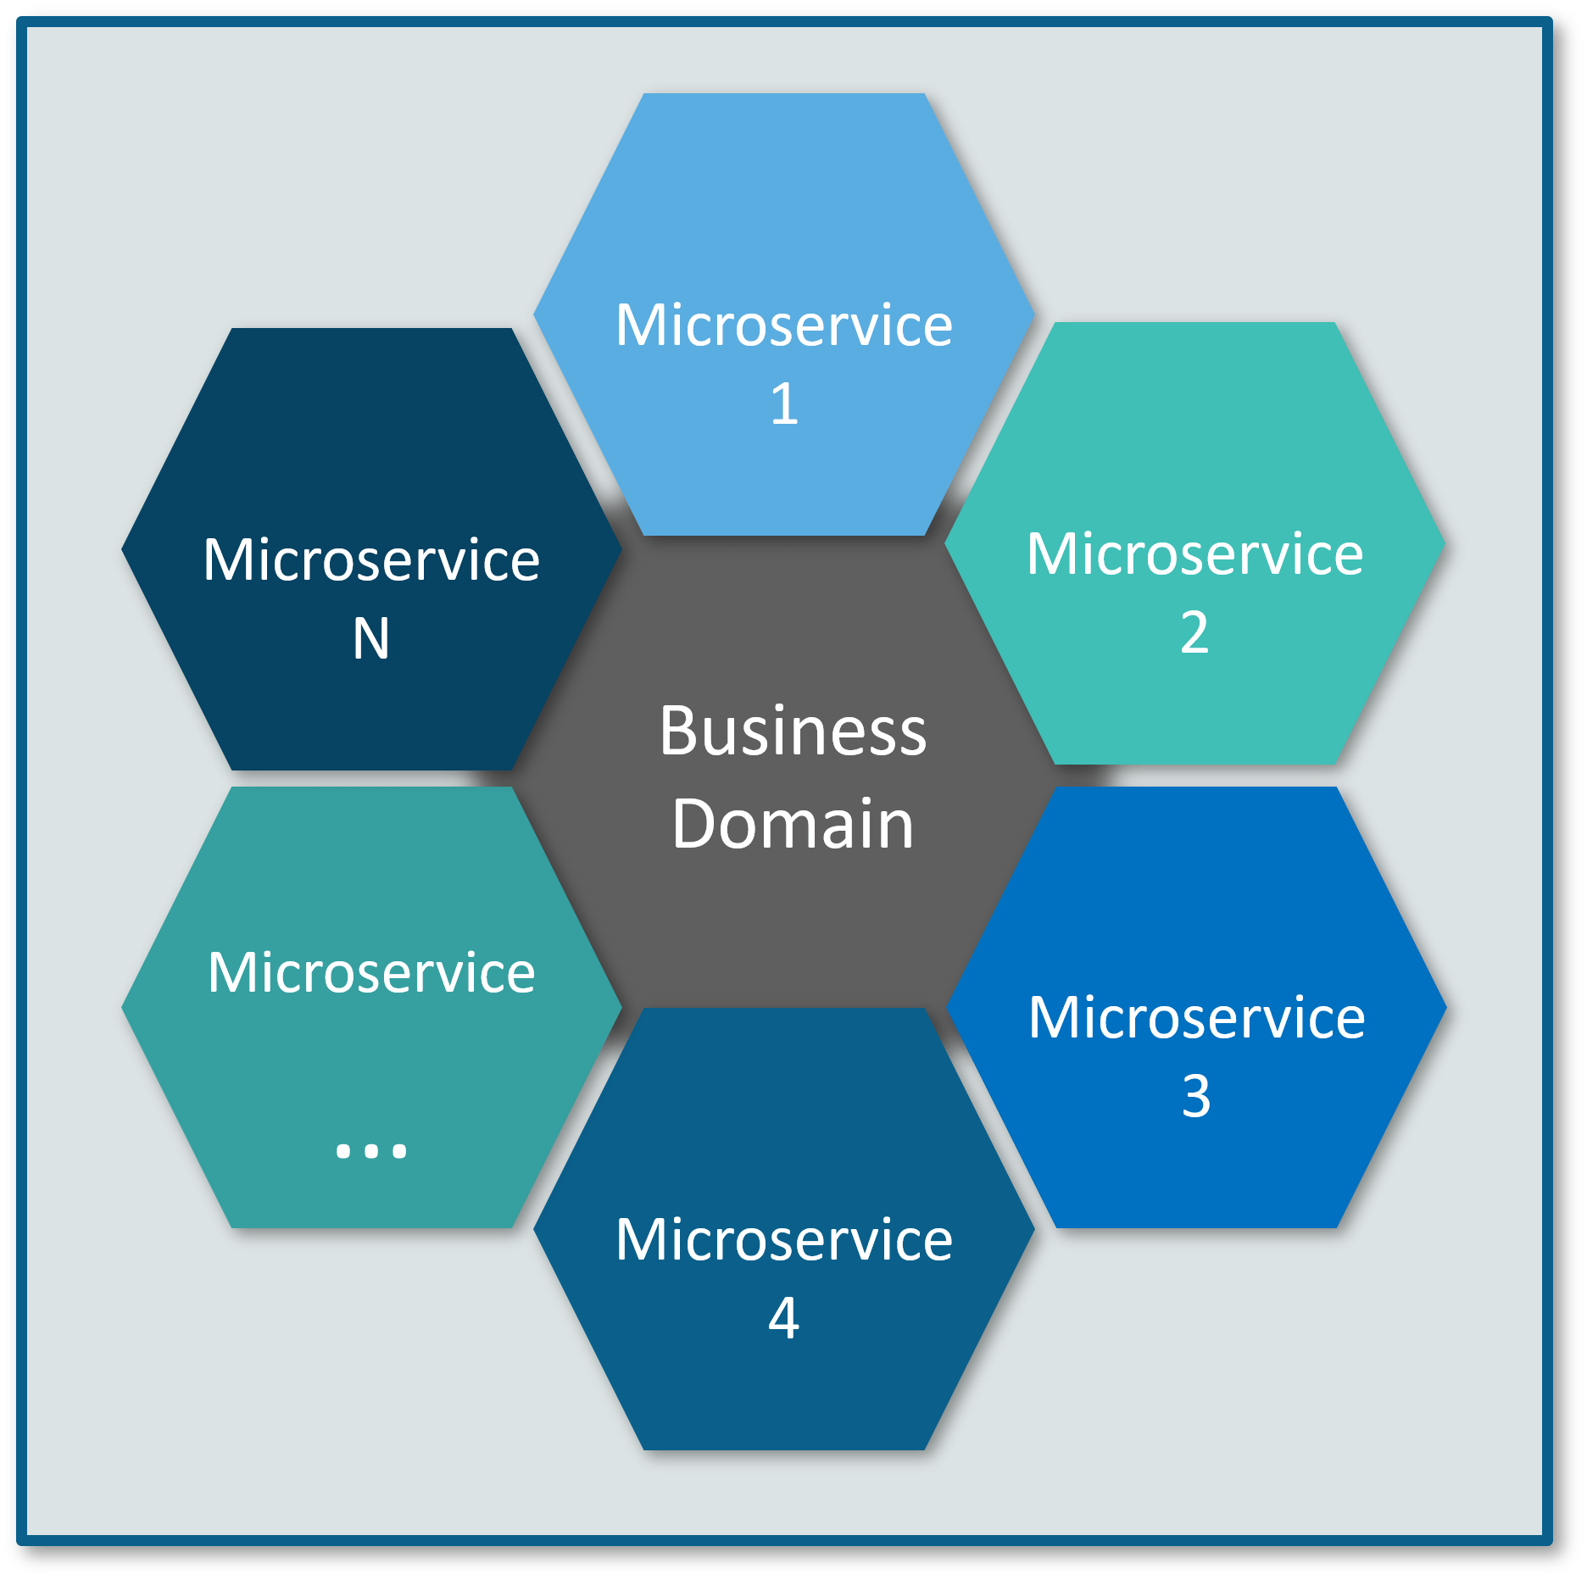
Microservices
The microservice architectural style is an approach to developing a single application as a suite of small services, each running in its own process and communicating with lightweight mechanisms, often an HTTP resource API, Async Messaging
Microservices are built around business capabilities and independently deployable by fully automated deployment machinery

Slide 13
What Are Microservices?
They are a type of service-oriented architecture (SOA), albeit one that is opinionated about how service boundaries should be drawn, and that independent deploy ability is key.
Microservices also have the advantage of being technology agnostic

Slide 14

Source

Slide 15
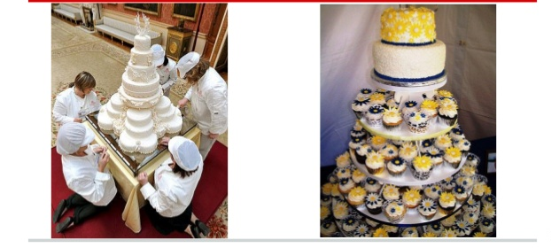
Monolith VS Microservices(distributed)

Slide 16
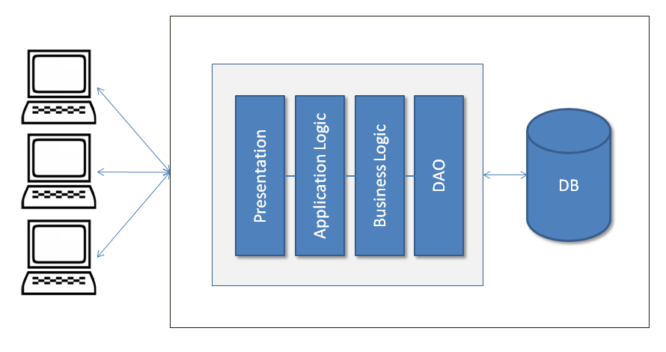
Monolith Architecture
Single Deployment
Single Process
Single Codebase

Slide 17
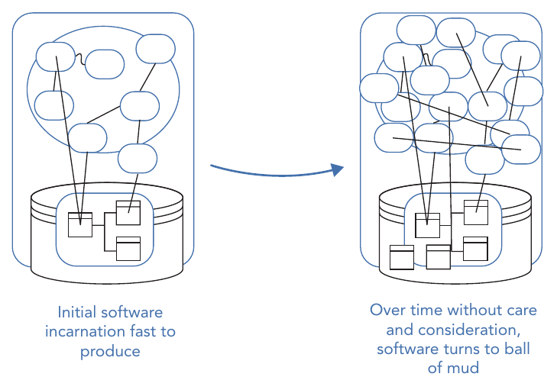
Big bull of mud

Slide 18
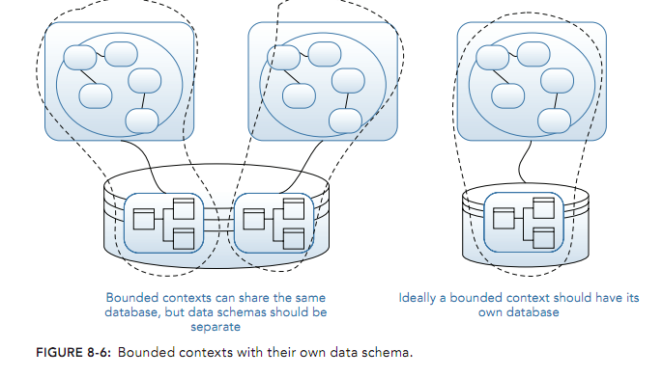
Modular Monolith
As a subset of the single process monolith, the modular monolith is a variation: the single process consists of separate modules, each of which can be worked on inde‐pendently, but which still need to be combined for deployment

Slide 19

Advantage of Monolith

Slide 20
Advantage of Monolith
Simple to develop IDEs and other developer tools are focused on building a single application
Easy to make radical changes to the application You can change the code and the database schema, build, and deploy
Straightforward to test The developers wrote end-to-end tests that launched the application, invoked the REST API, and tested the UI with Selenium

Slide 21
Advantage of Monolith
Straightforward to deploy All a developer had to do was copy the WAR file to a server that had Tomcat installed
Easy to scale multiple instances of the application behind a load balancer
Simplify code reuse within the monolith itself(same codebase, same programing language,…)

Slide 22

Disadvantage of Monolith

Slide 23
Complexity Intimidates developers
Large code developers wanting to change the same piece of code ,different teams wanting to push functionality live at different times
It’s too large for any developer to fully understand .as a result, fixing bugs and correctly implementing new features have become difficult and time consuming. Easy to scale—FTGO ran multiple instances of the application behind a load balancer
Monoliths can also simplify code reuse within the monolith itself

Slide 24
Development is Slow
Developers find day-to-day development tasks slow. The large application overloads and slows down a developer’s IDE.
Building the application takes a long time.
Moreover, because it’s so large, the application takes a long time to start up

Slide 25
Scaling is Difficult !!
That’s because different application modules have conflicting resource requirements. Some module persists their data in memory, some modules need CPU Processes.

Slide 26
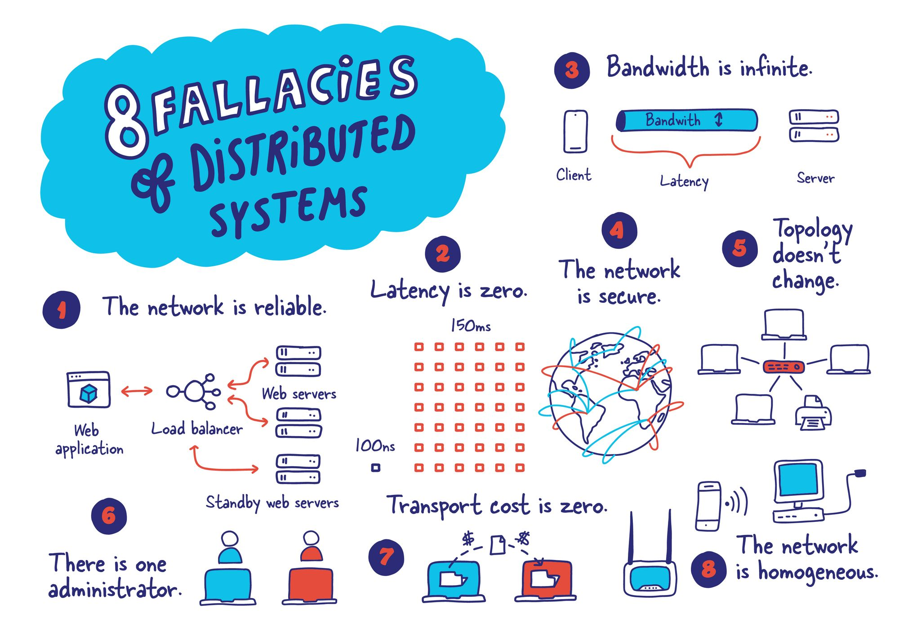

Slide 27
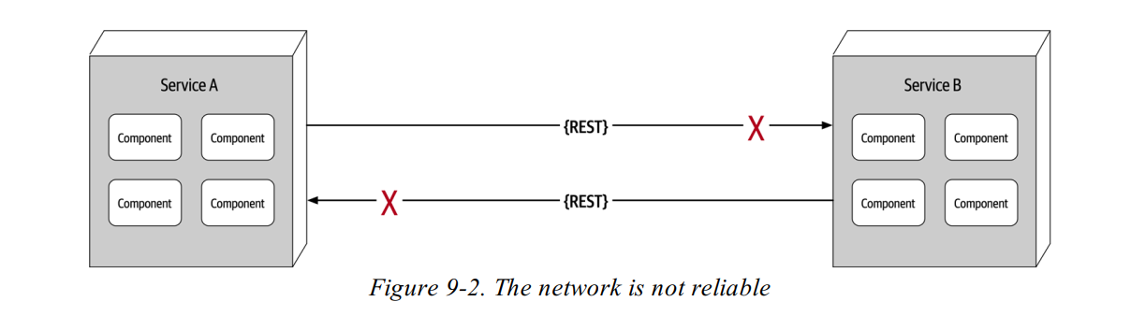
Fallacy #1: The Network Is Reliable
Service B may be totally healthy, but Service A cannot reach it due to a network problem
Service A made a request to Service B to process some data and does not receive a response because of a network issue

Slide 28
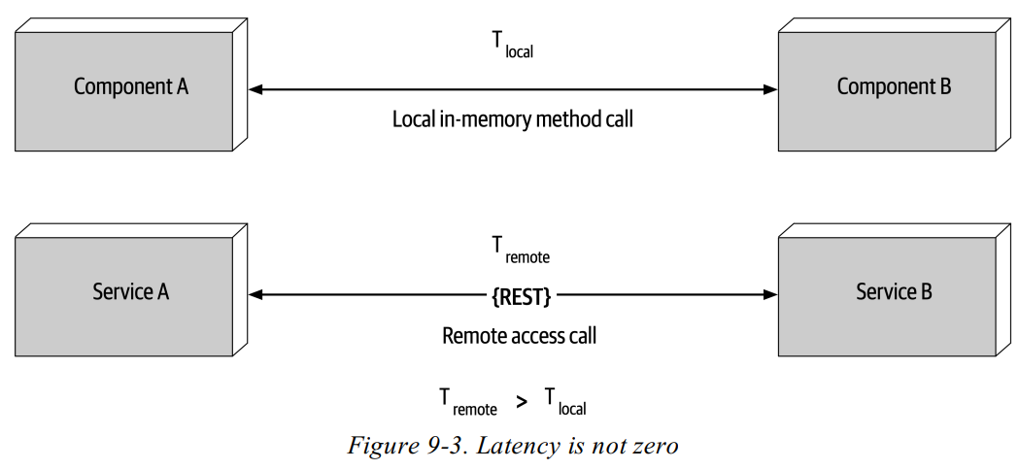
Fallacy #2: Latency is zero

Slide 29
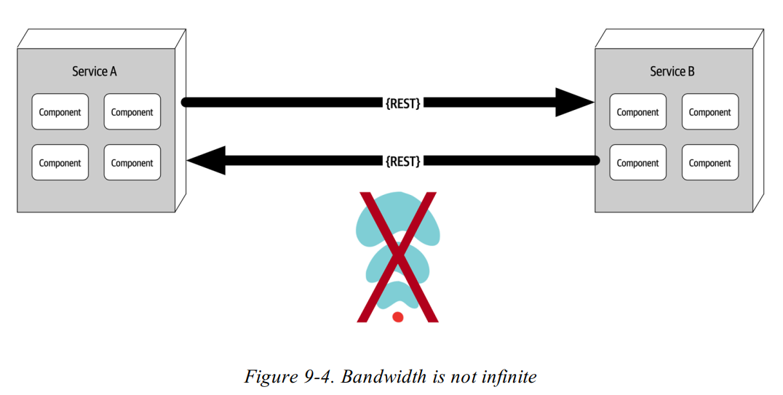
Fallacy #3: Bandwidth is infinite
Design your applications with bandwidth usage in mind

Slide 30
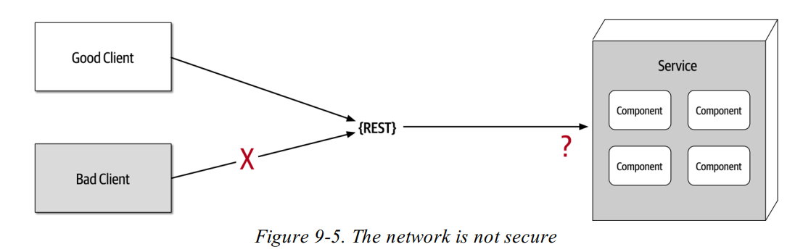
Fallacy #4: The Network Is Secure

Slide 31
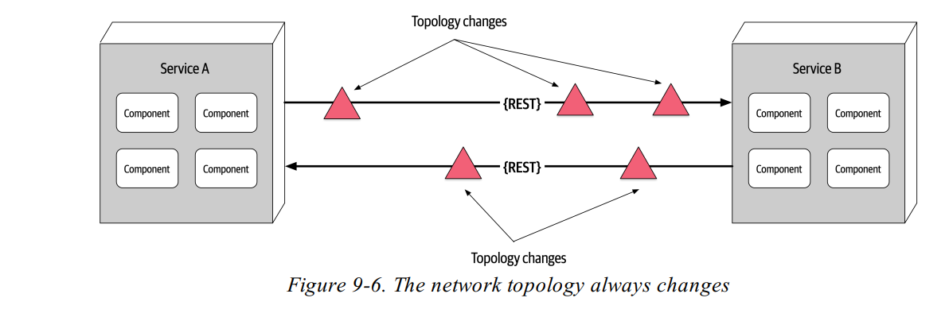
Fallacy #5: Topology doesn't change

Slide 32
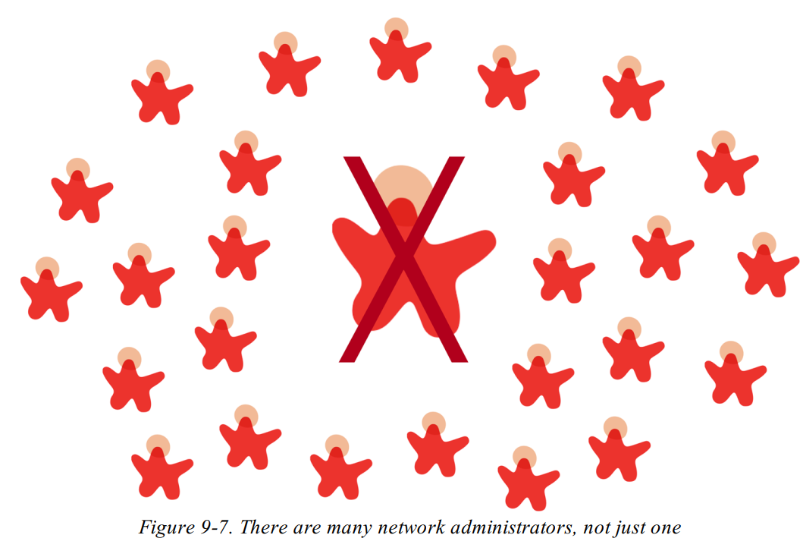
Fallacy #6: There is one administrator
Put governance in place that makes it easy to troubleshoot any issues that arise
Modern cloud-native applications are composed of many services, working together but developed by different teams. It’s practically impossible for a single person to know and understand the whole application, let alone try to fix all the issues.

Slide 33
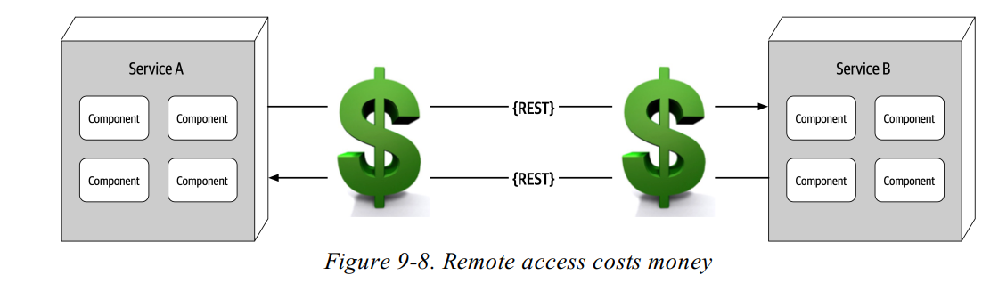
Fallacy #7:Transport Cost is zero
There’s a cost to object serialization and deserialization. Both operations can be expensive in terms of performance

Slide 34
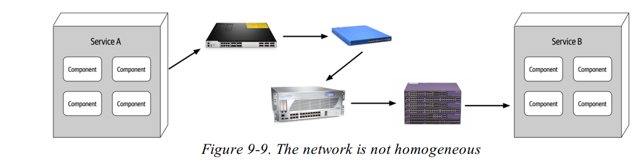
Fallacy #8: The network is homogeneous
You can’t assume that the network hardware always stays the same. The key point is to focus on standard protocols so that components can communicate, regardless of the hardware

Slide 35
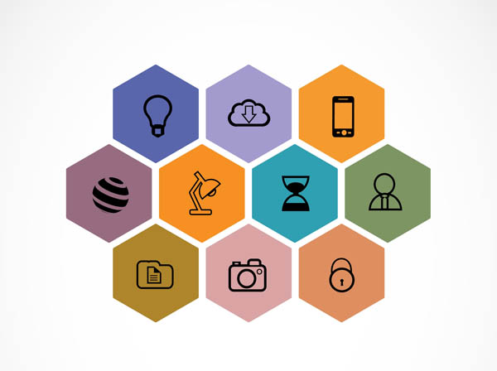
Microservices

Slide 36
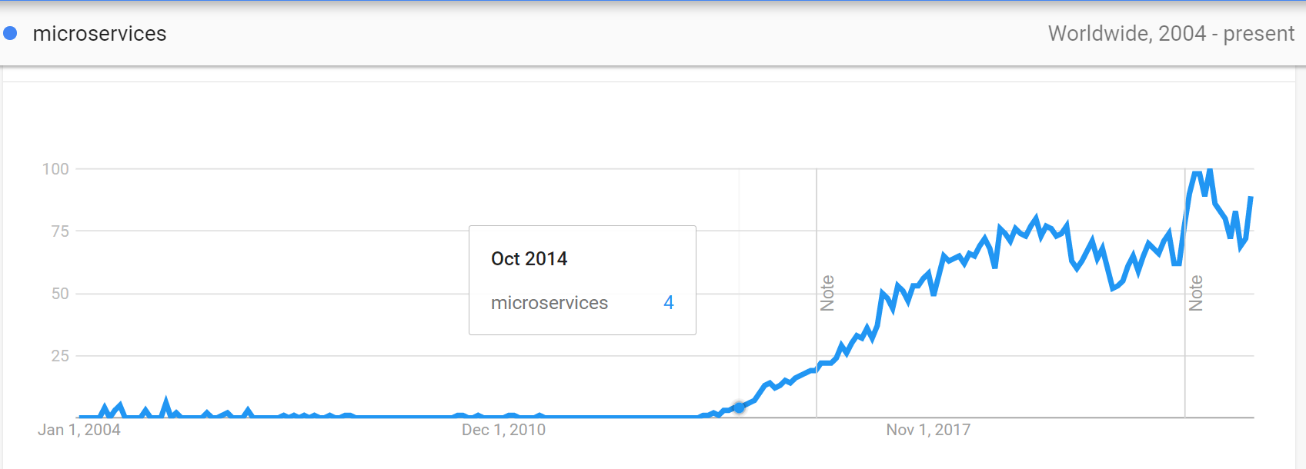
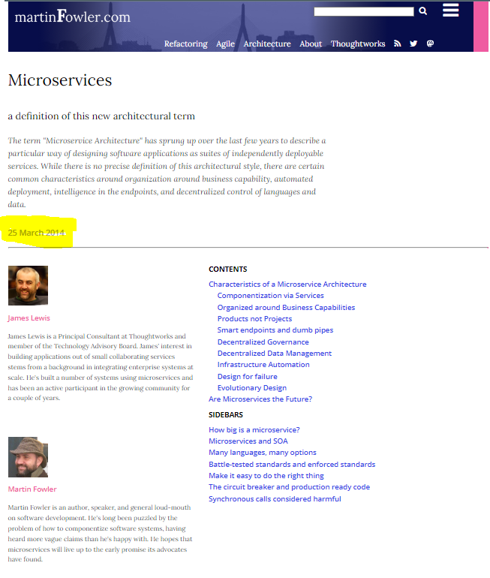
Microservices

Slide 37
Advantage of Microservices

Slide 38
Advantage of Microservices
It enables the continuous delivery and deployment of large, complex applications.
Services are small and easily maintained.
Services are independently deployable.
Services are independently scalable.
The microservice architecture enables teams to be autonomous.
It allows easy experimenting and adoption of new technologies.
It has better fault isolation

Slide 39
It enables the continuous delivery and deployment of large, complex applications
It has the testability required by continuous delivery/deployment
Automated testing is a key practice of continuous delivery/deployment. Because each service in a microservice architecture is relatively small, automated tests are much easier to write and faster to execute. As a result, the application will have fewer bugs

Slide 40
It enables the continuous delivery and deployment of large, complex applications
It has the deployability required by continuous delivery/deployment
Each service can be deployed independently of other services. If the developers responsible for a service need to deploy a change that’s local to that service, they don’t need to coordinate with other developers. They can deploy their changes. As a result, it’s much easier to deploy changes frequently into production.

Slide 41
It enables the continuous delivery and deployment of large, complex applications
It enables development teams to be autonomous and loosely coupled
You can structure the engineering organization as a collection of small (for example, two-pizza) teams. Each team is solely responsible for the development and deployment of one or more related services. each team can develop, deploy, and scale their services independently of all the other teams. As a result, the development velocity is much higher.

Slide 42
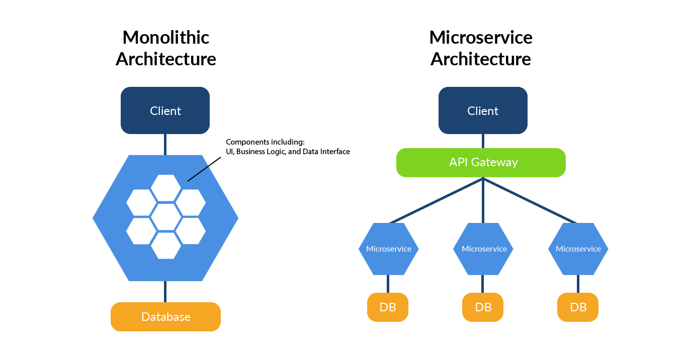
Services are small and easily maintained
The code is easier for a developer to understand. The small code base doesn’t slow down the IDE, making developers more productive. And each service typically starts a lot faster than a large monolith does, which also makes developers more productive and speeds up deployments.

Slide 43
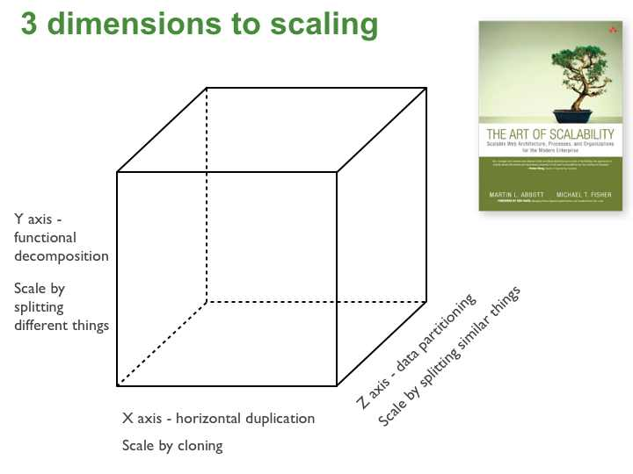
Services are independently deployable.
Each service in a microservice architecture can be scaled independently of other services using X-axis cloning and Z-axis partitioning. Moreover, each service can be deployed on hardware that’s best suited to its resource requirements.

Slide 44
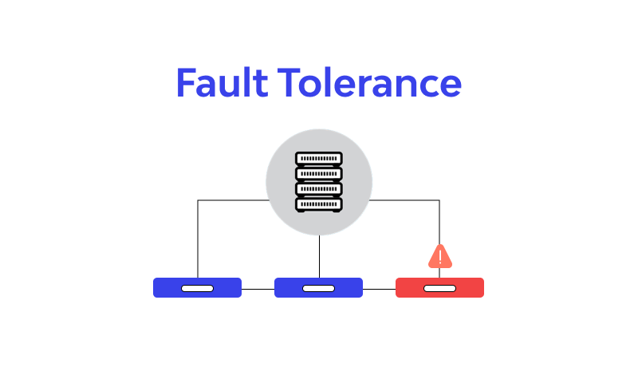
It has better fault isolation
The microservice architecture has better fault isolation. For example, a memory leak in one service only affects that service. Other services will continue to handle requests normally. In comparison, one misbehaving component of a monolithic architecture will bring down the entire system.

Slide 45
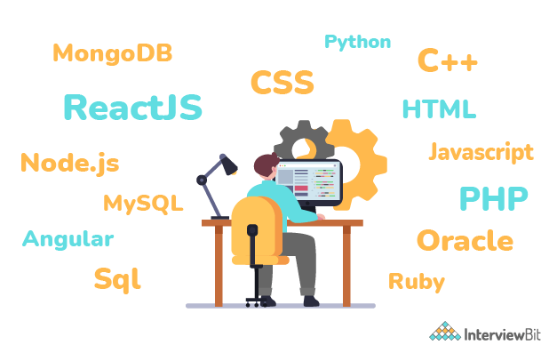
It allows easy adoption of new technologies
microservice architecture eliminates any long-term commitment to a technology stack. In principle, when developing a new service, the developers are free to pick whatever language and frameworks are best suited for that service

Slide 46
Disadvantage of Microservices

Slide 47
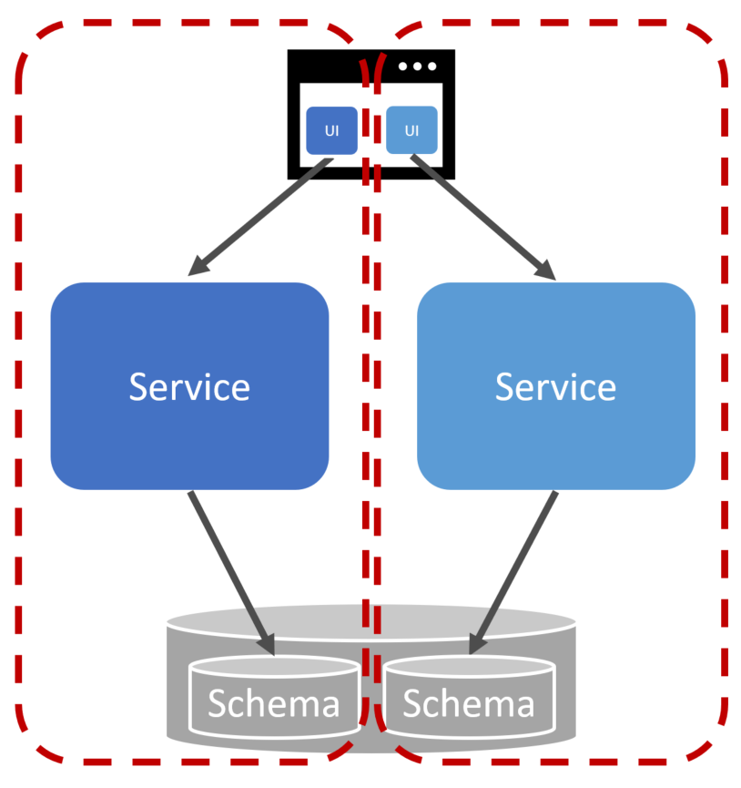
FINDING THE RIGHT SERVICES IS CHALLENGING
One challenge with using the microservice architecture is that there isn’t a concrete, well-defined algorithm for decomposing a system into services. As with much of software development, it’s something of an art. To make matters worse, if you decompose a system incorrectly, you’ll build a distributed monolith, a system consisting of coupled services that must be deployed together.

Slide 48

DISTRIBUTED SYSTEMS ARE COMPLEX
Another issue with using the microservice architecture is that developers must deal with the additional complexity of creating a distributed system.
Services must use an inter-process communication mechanism. This is more complex than a simple method call.
A service must be designed to handle partial failure and deal with the remote service either being unavailable or exhibiting high latency
Notes:
Debug, Trace
Martin Fowler : My First Law of Distributed Object Design: Don't distribute your objects

Slide 49

CAREFUL COORDINATION
Another challenge with using the microservice architecture is that deploying features that span multiple services requires careful coordination between the various development teams.
Notes:
Pass a use case need to multiple service

Slide 50

DECIDING WHEN TO ADOPT IS DIFFICULT
Another issue with using the microservice architecture is deciding at what point during the lifecycle of the application you should use this architecture.
When developing the first version of an application, you often don’t have the problems that this architecture solves. Moreover, using an elaborate, distributed architecture will slow down development.
A startup should almost certainly begin with a monolithic application

Slide 51

Developer Experience
As you have more and more services, the developer experience can begin to suffer. More resource-intensive runtimes like the JVM can limit the number of microservices that can be run on a single developer machine

Slide 52

Technology Overload !!
Microservices may well give you the option for each microservice to be written in a different programming language, to run on a different runtime, or to use a different database—but these are options, not requirements. You have to carefully balance the breadth and complexity of the technology you use against the costs that a diverse array of technology can bring.

Slide 53

Technology Overload
Run more things
More processes
More computers
More network
More storage
More supporting software
Note : Microservices are a poor choice for an organization primarily concerned with reducing costs, as a cost-cutting mentality

Slide 54
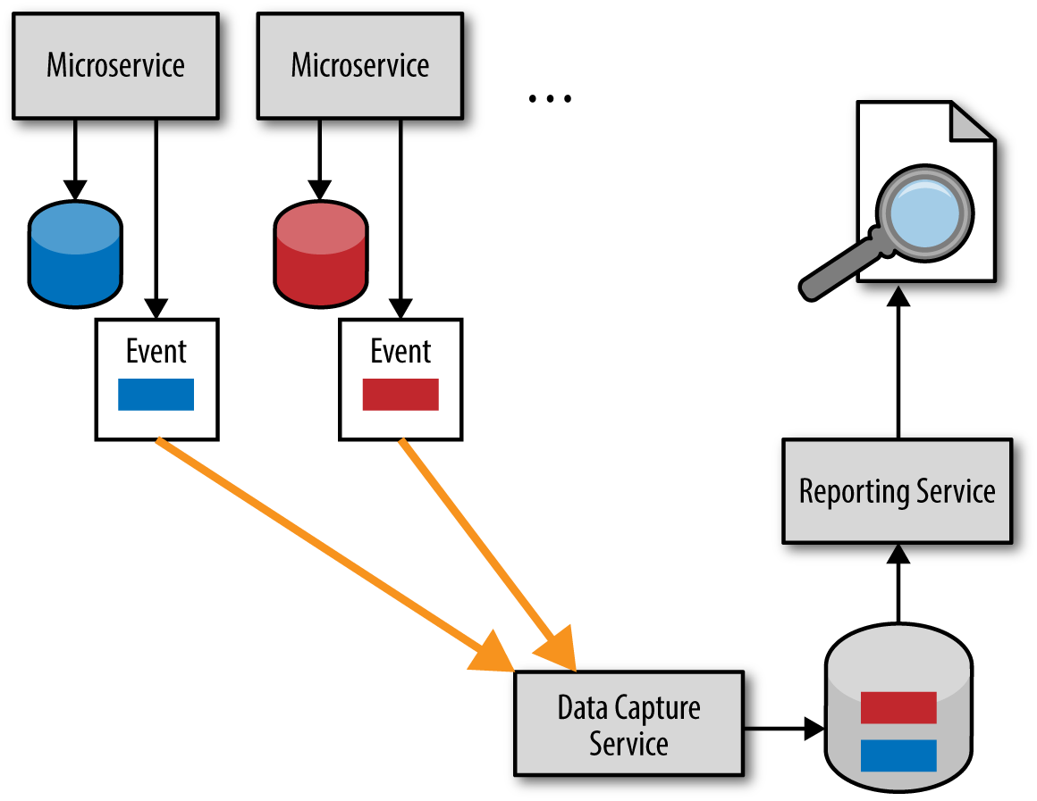
Reporting
With a monolithic system, you typically have a monolithic database With a microservice architecture, we have broken up this monolithic schema. That doesn’t mean that the need for reporting across all our data has gone away; we’ve just made it much more difficult, because now our data is scattered across multiple logically isolated schemas

Slide 55
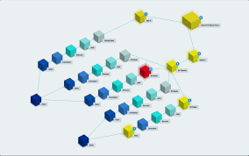
Monitoring and Troubleshooting
With a standard monolithic application, we can have a fairly simplistic approach to monitoring. We have a small number of machines to worry about, and the failure mode of the application is somewhat binary—the application is often either all up or all down.
With a microservice architecture with tens or hundreds of processes, can we say the same thing?

Slide 56

Latency
With a microservice architecture, processing that might previously have been done locally on one processor can now end up being split across multiple separate microservices. Information that previously flowed within only a single process now needs to be serialized, transmitted, and deserialized over networks that you might be exercising more than ever before

Slide 57

No Silver Bullet

Slide 58

Notes:
Microservices in action – page 7

Slide 59
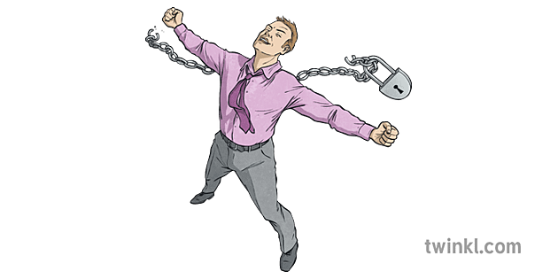
Autonomy
Each service operates and changes independently of others
Notes:
Each Service develop, deploy and work independently

Slide 60
Autonomy
Loosely coupled : Enables a team to work independently the majority of time on their service(s) without being impacted by changes to other services and without affecting other services
Independently deployable : Enables a team to deploy their service without having to coordinate with other teams

Slide 61

Resilience
Microservices are a natural mechanism for isolating failure: if you deploy them independently, application or infrastructure failure may only affect part of your system

Slide 62

Transparency
Most importantly, you need to know when a failure has occurred, and rather than one system, a microservice application depends on the interaction and behavior of multiple services, possibly built by different teams. At any point, your system should be transparent and observable to ensure that you both observe and diagnose problems.
Every service in your application will produce business, operational, and infrastructure metrics; application logs; and request traces. As a result, you’ll need to make sense of a huge amount of data.

Slide 63
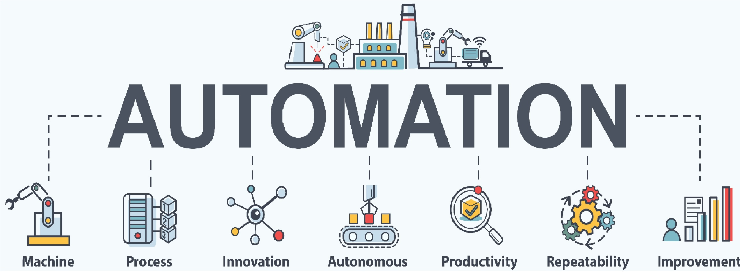
Automation
Microservices are a more complex architecture than building a single application. By embracing automation and seeking consistency in the infrastructure between services, you can significantly reduce the cost of managing this additional complexity.
You need to use automation to ensure the correctness of deployments and system operation

Slide 64

Alignment
In microservice architecture, each service should align to a single business capability, encapsulating all relevant technical layers

Slide 65
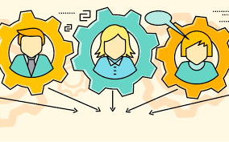
Service Communication

Slide 66
Interaction style
One-to-one—Each client request is processed by exactly one service.
One-to-many—Each request is processed by multiple services
Synchronous—The client expects a timely response from the service and might even block while it waits.
Asynchronous—The client doesn’t block, and the response, if any, isn’t necessarily sent immediately

Slide 67
One to One
Request / Response
A service client makes a request to a service and waits for a response. The client expects the response to arrive in a timely fashion. It might event block while waiting. This is an interaction style that generally results in services being tightly coupled

Slide 68
One to One
Asynchronous request/response A client sends a request to a service, which replies asynchronously. The client doesn’t block while waiting, because the service might not send the response for a long time
Notes:
https://reflectoring.io/amqp-request-response/

Slide 69
One to One
One-Way Notification A client sends a request to a service, but no reply is expected or sent.

Slide 70
One To Many
Publish/subscribe A client publishes a notification message, which is consumed by zero or more interested services.
Publish/async Response A client publishes a request message and then waits for a certain amount of time for responses from interested services

Slide 71


What are the fallacies of distributed computing

Slide 72
# Refactoring to microservices
How do you migrate a legacy monolithic application to a microservice architecture?

Slide 73
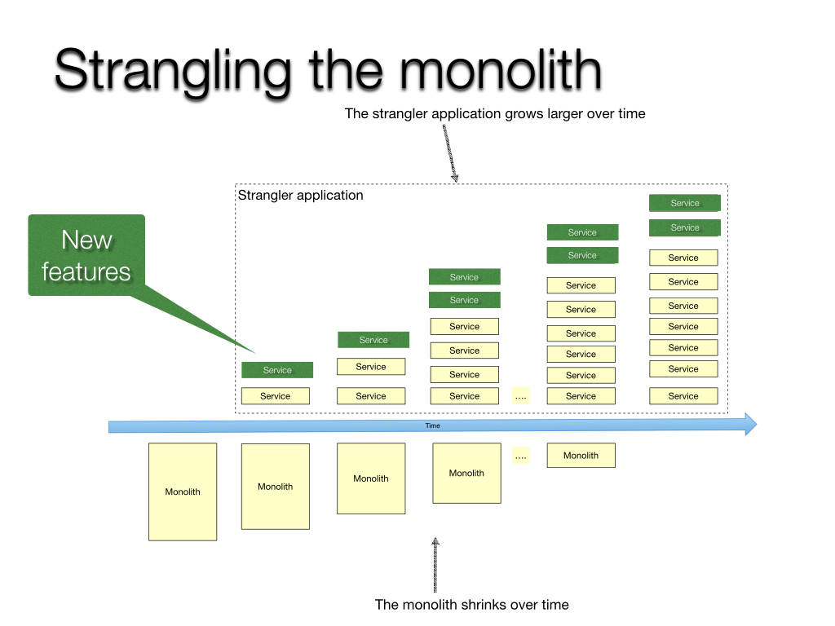

Implement new functionality as a service
Strangler fig

Slide 74
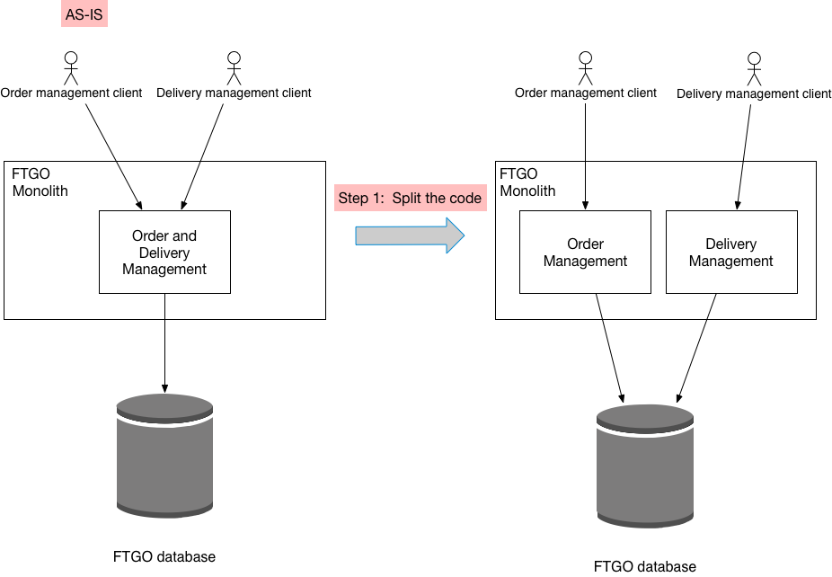
Extract services from the monolith
Step 1: Split the code
The first step is to split the code and convert delivery management into a separate, loosely coupled module within the monolith

Slide 75
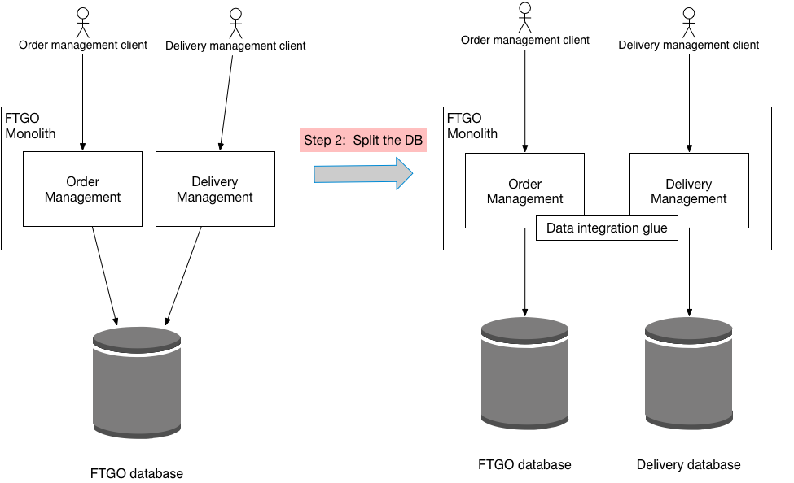
Extract services from the monolith
Step 2: Split the database
is to split the code and convert delivery management into a separate, loosely coupled module within the monolith

Slide 76
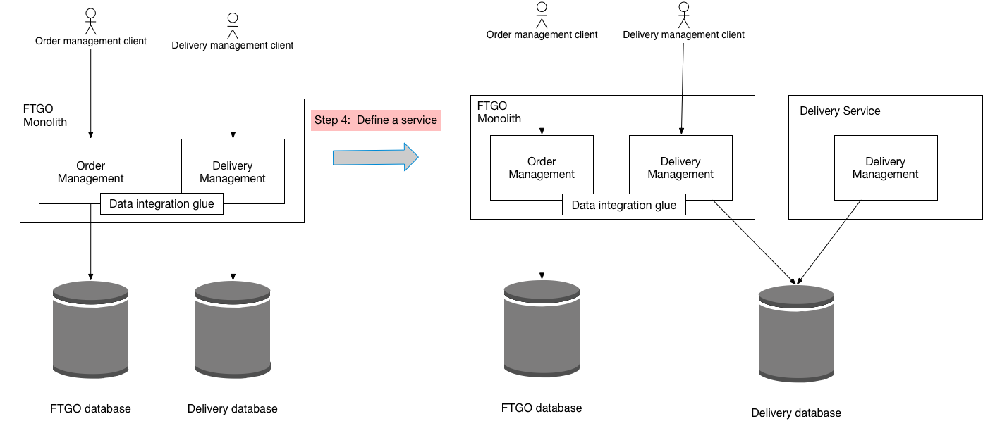
Extract services from the monolith
Step 3: Define a standalone Delivery Service
The third step of the refactoring process is to define a standalone Delivery Service and deploy it. The service does not, however, handle production traffic. Instead, it can, for example, be tested in production

Slide 77
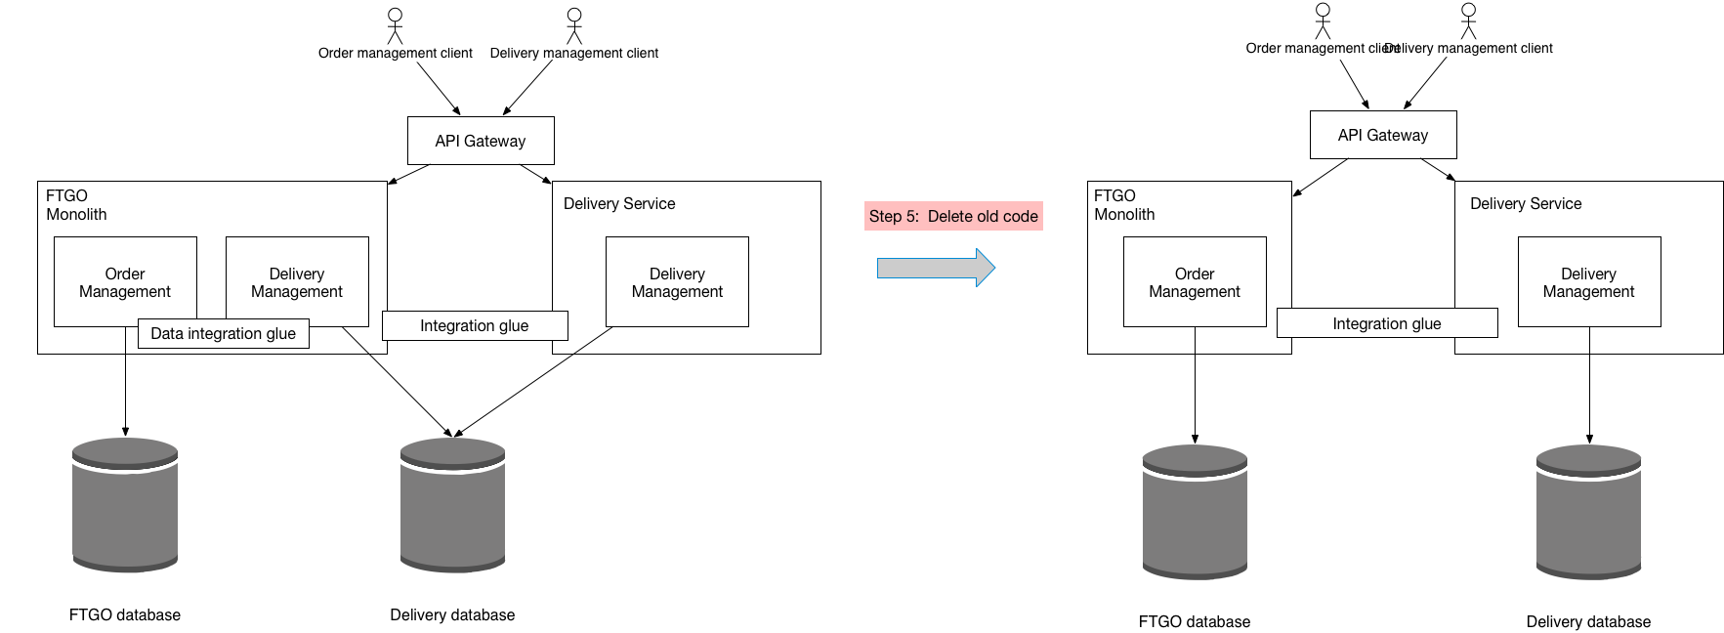
Extract services from the monolith
Step 4: Use the standalone Delivery Service
The fourth step of the refactoring process is to use the standalone Delivery Service

Slide 78

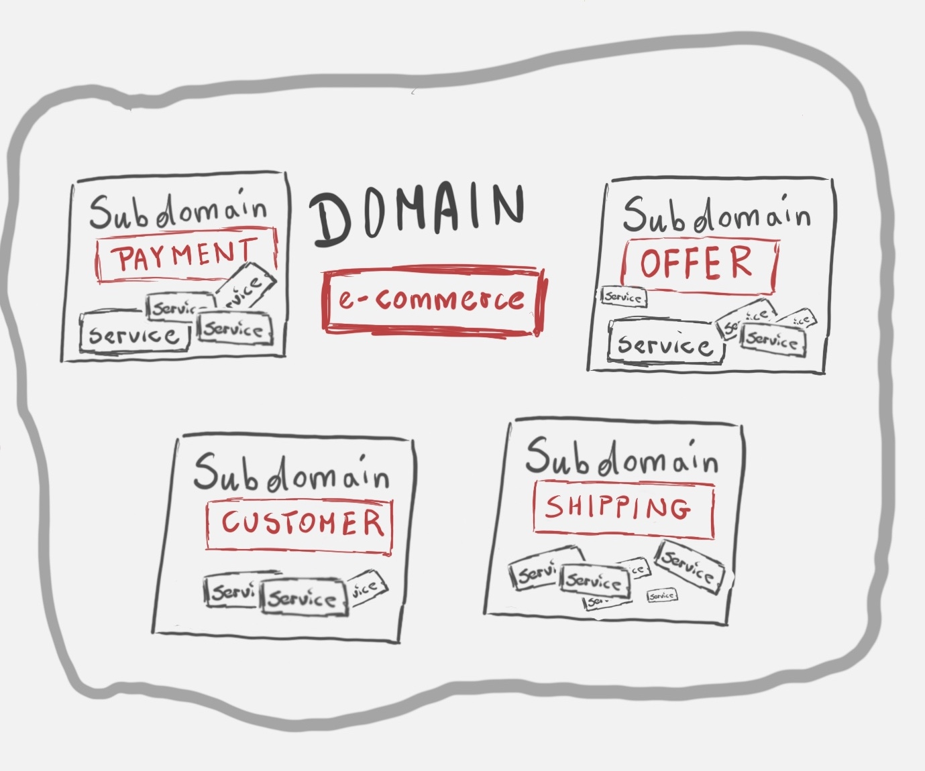
# How to decompose an application into services?
Define services corresponding to Domain-Driven Design (DDD) subdomains

Slide 79
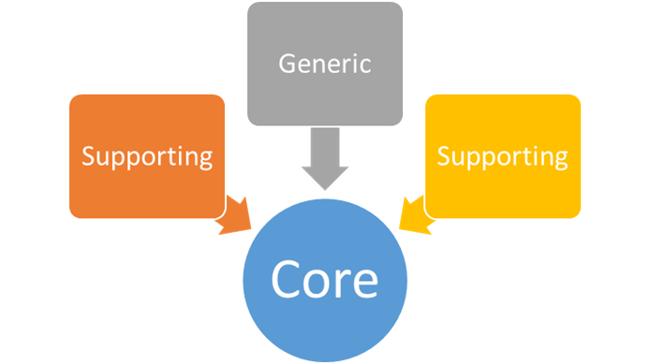
Domain Driven Design
DDD refers to the application’s problem space - the business - as the domain. Each subdomain corresponds to a different part of the business.
Subdomains can be classified as follows:
Core - key differentiator for the business and the most valuable part of the application
Supporting - related to what the business does but not a differentiator. These can be implemented in-house or outsourced.
Generic - not specific to the business and are ideally implemented using off the shelf software
Examples

Slide 80
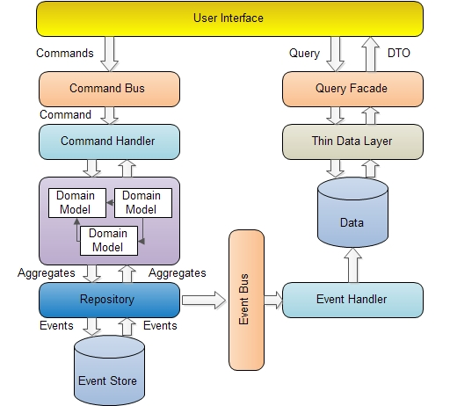
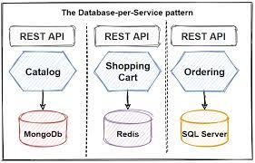
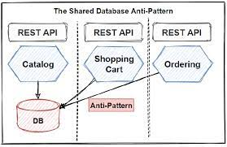
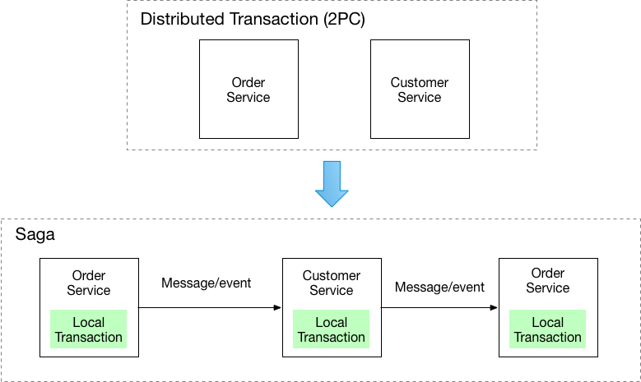
# How to maintain data consistency

Slide 81
Shared database
The benefits of this pattern are:
A developer uses familiar and straightforward ACID transactions to enforce data consistency
A single database is simpler to operate
The drawbacks of this pattern are:
Development time coupling - a developer working on, for example, the OrderService will need to coordinate schema changes with the developers of other services that access the same tables.
Runtime coupling - because all services access the same database they can potentially interfere with one another.

Slide 82
Database Per Service
The benefits of this pattern are:
Each service can use the type of database that is best suited to its needs
Changes to one service’s database does not impact any other services
The drawbacks of this pattern are:
Transaction Management is complex (Use SAGA)
Implementing queries that join data that is now in multiple databases is challenging (CQRS, ApiComposition)
Complexity of managing multiple SQL and NoSQL database

Slide 83
How to implement transactions that span services?
Pattern : SAGA
A saga is a sequence of local transactions.
If a local transaction fails because it violates a business rule then the saga executes a series of compensating transactions that undo the changes that were made by the preceding local transactions

Slide 84
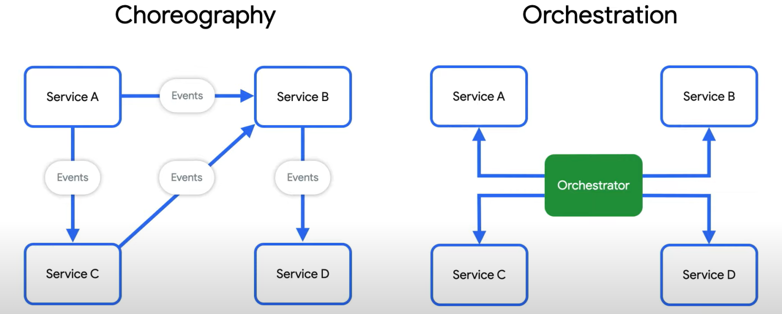
Ways of coordination sagas

Slide 85
Retrieves data from multiple services
Pattern : CQRS
Define a view database, which is a read-only replica that is designed to support that query. The application keeps the replica up to data by subscribing to Domain events published by the service that own the data.

Slide 86
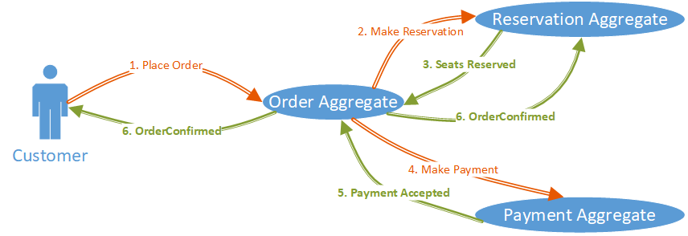
How does a service publish an event when it updates its data?
Pattern :DomainEvent
Organize the business logic of a service as a collection of DDD aggregates that emit domain events when they created or updated.

Slide 87
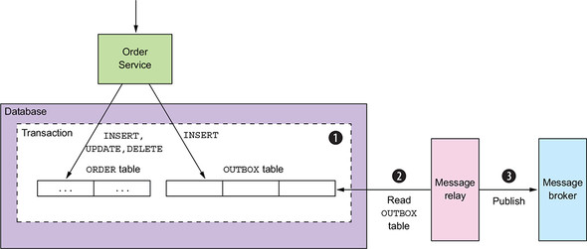
How to reliably/atomically update the database and send messages/events?
Pattern: Transactional outbox
A service that uses a relational database inserts messages/events into an outbox table (e.g. MESSAGE) as part of the local transaction. An service that uses a NoSQL database appends the messages/events to attribute of the record (e.g. document or item) being updated. A separate Message Relay process publishes the events inserted into database to a message broker.
Consumers usually need to be idempotent

Slide 88
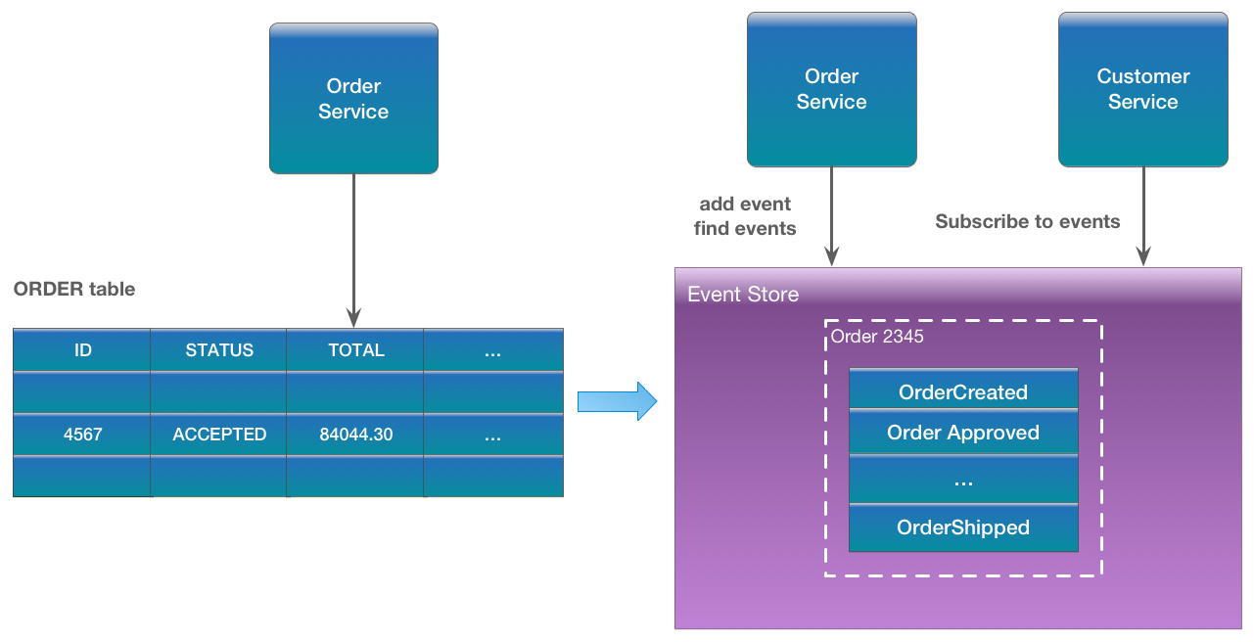
How to reliably/atomically update the database and send messages/events?
Pattern: Event Sourcing
Applications persist events in an event store, which is a database of events. The store has an API for adding and retrieving an entity’s events
The event store also behaves like a message broker. It provides an API that enables services to subscribe to events. When a service saves an event in the event store, it is delivered to all interested subscribers.

Slide 89
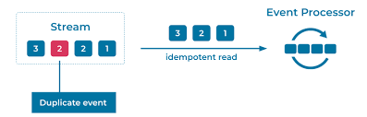
How does a message consumer handle duplicate messages correctly
Pattern: Idempotent Consumer
You can make a consumer idempotent by recording in the database the IDs of the messages that it has processed successfully. When processing a message, a consumer can detect and discard duplicates by querying the database.

Slide 90
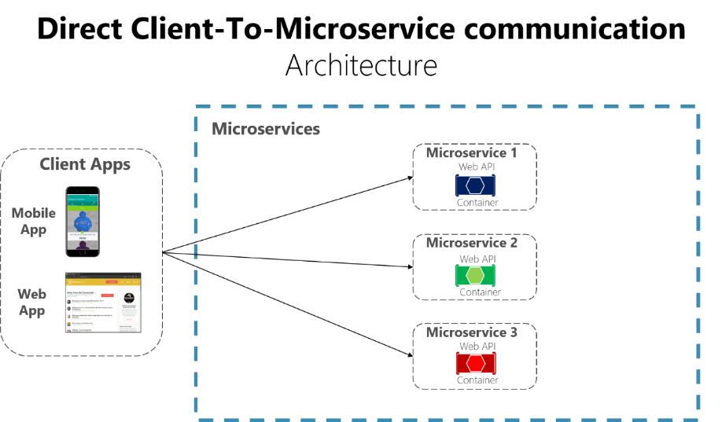

# How client access the services?
Pattern: API Gateway

Slide 91


How does the client of a service discover the location of a service instance?
Pattern: Service Discovery
When making a request to a service, the client obtains the location of a service instance by querying a Service Registry, which knows the locations of all service instances

Slide 92

How to prevent a network or service failure from cascading to other services?
Pattern: Circuit Breaker
When the number of consecutive failures crosses a threshold, the circuit breaker trips, and for the duration of a timeout period all attempts to invoke the remote service will fail immediately. After the timeout expires the circuit breaker allows a limited number of test requests to pass through.

Slide 93


# Observability
Log aggregation
Collecting information across multiple microservices, a vital building block of any monitoring or observability solution
Metrics aggregation
Capturing raw numbers from our microservices and infrastructure to help detect problems, drive capacity planning, and perhaps even scale our applications
Distributed tracing
Tracking a flow of calls across multiple microservice boundaries to work out what went wrong and derive accurate latency information
Are you doing OK?
Looking at error budgets, SLAs, SLOs, and so on to see how they can be used as part of making sure our microservice is meeting the needs of its consumers
Alerting
What should you alert on? What does a good alert look like?

